Slide 1
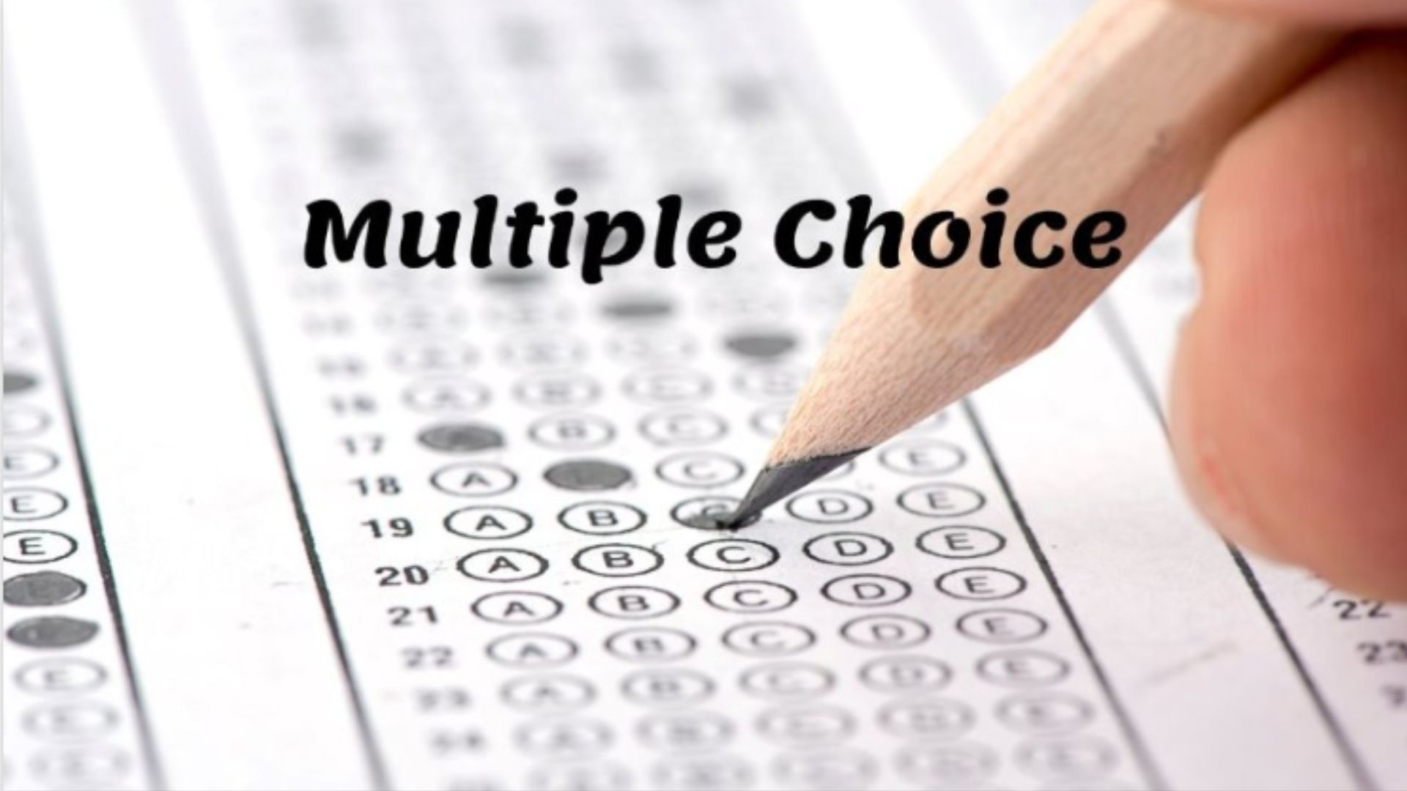

Slide 2
What TV series has the most watched series finale ever?
A) M*A*S*H
B) Seinfeld
C) Cheers
D) Friends

Slide 3
Regina is the capital of what Canadian province?
A) Halifax
B) Nova Scotia
C) Saskatchewan
D) Manitoba

Slide 4
Chik-Fil-A sponsors what college football bowl game?
A) Peach Bowl
B) Sugar Bowl
C) Cotton Bowl
D) Orange Bowl

Slide 5
Arthur Curry is the alter ego to what comic character?
A) Cyclops
B) Green Lantern
C) Aqua man
D) Dare Devil

Slide 6
What Stephen King novel has the most pages?
A) The Stand
B) Carrie
C) IT
D) Pet Cemetery

Slide 7
Mandark (Hahaha!-HA!-haHA-haHA!) is an antagonist on what TV show?
A) Space Ghost
B) Ren & Stimpy
C) Dexter’s Lab
D) Johnny Bravo

Slide 8
Which of these elements has the highest atomic number?
A) Gold
B) Silver
C) Titanium
D) Platinum

Slide 9
What State has the only freeway measured in Metric in the US?
A) North Dakota
B) New Mexico
C) Arizona
D) Minnesota

Slide 10
What country does Heineken beer originate from?
A) The Netherlands
B) France
C) Germany
D) Switzerland

Slide 11
A “Glizzy-Guzzler” is someone who eats a lot of what?
A) Donuts
B) Pickles
C) Hot Dogs
D) Eggplant

Slide 12
Multiple Choice
1. What TV series has the most watched series finale ever?
2. Regina is the capital of what Canadian province?
3. Chik-Fil-A sponsors what college football bowl game?
4. Arthur Curry is the alter ego to what comic character?
5. What Stephen King novel has the most pages?
6. Mandark (Hahaha!-HA!-haHA-haHA!) is an antagonist on what TV show?
7. Which of these elements has the highest atomic number?
8. What State has the only freeway measured in Metric in the US?
9. What country does Heineken beer originate from?
10. A “Glizzy-Guzzler” is someone who eats a lot of what?

Slide 14
1. M*A*S*H
2. Saskatchewan
3. Peach Bowl
4. Aqua man
5. The Stand
6. Dexter’s Lab
7. Gold
8. Arizona
9. The Netherlands
10. Hot Dogs

